Slide 1
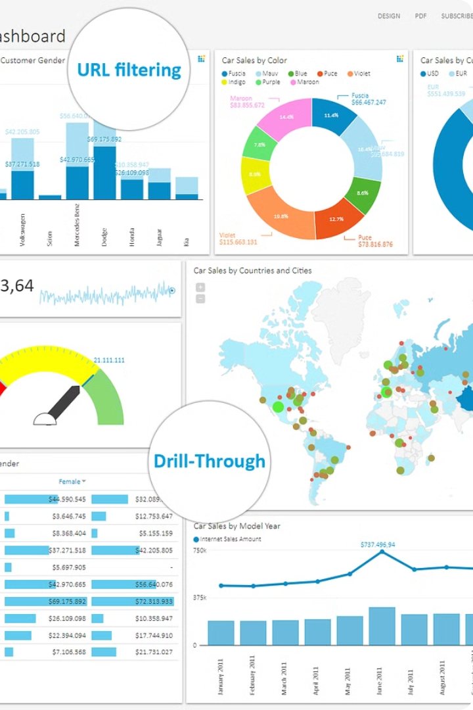


CSA1580 CLOUD COMPUTING FOR BIG DATA
ANLYTICS FOR CLOUD API
The Challenge of Real-Time Analytics
Today's digital platforms generate vast amounts of data. This data offers valuable insights into user behavior and engagement, but extracting meaningful information in real-time presents significant challenges.
Presented by
T.Naga veeranjineyulu
192211998

Slide 2
The Power of Apache Cassandra for Scalability
Apache Cassandra is a NoSQL database designed for high availability, scalability, and performance. It provides a distributed, fault-tolerant platform for storing large volumes of data that can be accessed in real-time.
Cassandra's decentralized architecture and distributed data storage ensure continuous operation even if some nodes are unavailable, allowing for high availability and resilience. It is ideal for handling high write throughput and low latency, crucial for applications dealing with massive amounts of user activity data.

Slide 3

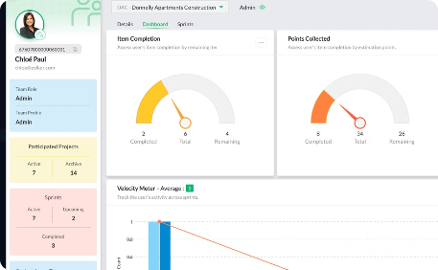

Understanding the Data: User Interactions and Insights
Likes, Comments, and Shares
Posts and Content Creation
Real-Time Analysis
Analyzing user activities in real-time provides a dynamic understanding of evolving trends and immediate feedback.
User interactions are the lifeblood of social media, reflecting engagement and sentiment. This data reveals user preferences and trends.
Posts and content created by users provide valuable insights into their interests, passions, and thought processes.

Slide 4





Designing a Cassandra Schema for User Activities
User ID
A unique identifier for each user, stored as a primary key, to enable efficient retrieval of user-specific data.
Activity Type
Categorizes the user's actions, like 'like', 'comment', 'share', or 'post', for targeted analysis.
Timestamp
Records the time of the activity, essential for analyzing trends, patterns, and real-time insights.
Content ID
Links the activity to a specific piece of content, such as a post or article, enabling analysis of content popularity.
Additional Data
May include other relevant information, such as the content type, user location, or engagement metrics, depending on the analytics requirements.

Slide 5
Key Considerations for Data Modeling
Data Consistency
Query Optimization
Scalability and Availability
Security and Privacy
Maintaining data consistency is essential for accurate analytics. Ensure all data is correct and up-to-date to generate reliable insights.
Optimize Cassandra queries to minimize latency and ensure efficient data retrieval. Leverage appropriate indexes and partition keys.
Design a schema that can scale horizontally to handle massive data volumes. Ensure high availability to minimize downtime and ensure continuous data ingestion.
Implement strong security measures to protect user data. Encrypt sensitive information and control access to prevent unauthorized access.

Slide 6
Building a Data Ingestion Pipeline
1
Data Capture
This involves collecting user activity data from various sources, such as the platform's API, mobile apps, or third-party integrations.
2
Data Cleaning and Transformation
The collected data must be validated, cleaned, and transformed into a format suitable for storage in Cassandra.
3
Data Ingestion into Cassandra
Using Cassandra's data ingestion mechanisms, the processed data is loaded into the tables designed in the previous step.

Slide 7
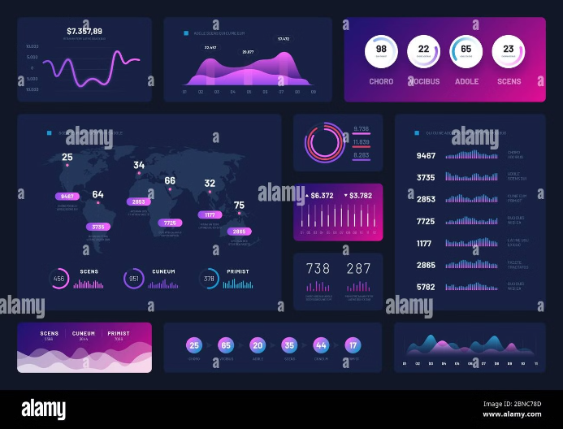
Real-Time Analytics Dashboard Design
A user-friendly dashboard is crucial for visualizing real-time analytics. It should present key performance indicators (KPIs) such as engagement metrics, user growth, and trending topics. Customizable dashboards allow users to filter and analyze data based on specific needs.
Interactive visualizations such as charts, graphs, and heatmaps provide insightful patterns and trends in user activity. These visuals should be visually appealing and easily understandable.

Slide 8

Visualizing User Activity Trends
The real-time analytics dashboard presents key user metrics in visually compelling charts and graphs.
These insights empower decision-makers to identify trends, understand user behavior, and make data-driven decisions.

Slide 9



The Benefits of a Real-Time Analytics Solution
Improved Decision-Making
Increased Revenue
Enhanced User Experience
By understanding user preferences and trends, you can optimize content, personalize experiences, and drive user engagement for higher revenue.
Real-time data provides valuable insights into user behavior, enabling informed decision-making and strategic adjustments.
Real-time analytics allows for quick identification and resolution of issues, leading to a smoother and more enjoyable user experience.

Slide 10
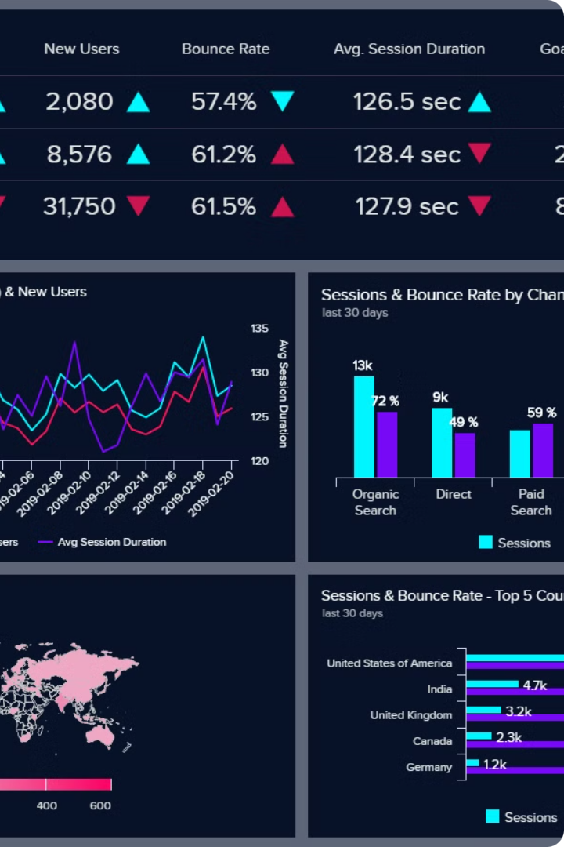
Conclusion and Future Directions
By implementing a scalable data storage solution with Apache Cassandra and a real-time analytics dashboard, you gain valuable insights into user activity. This empowers you to make data-driven decisions to improve platform features, personalize user experiences, and drive engagement.

